Slide 1
FD PRESERVATION IN 3NF AND BCNF DECOMPOSITION
Anisha Radhakrishnan
CSE Department

Slide 2
FD Preservation in 3NF AND BCNF Decomposition
→ 3NF and BCNF does not ensure FD is preserved. Avoid redundancy
Why FD should be preserved ?
Some FD is lost while joining
Avoid big joins

Slide 3
DEPENDENCY PRESERVING
R = (A, B, C),
F = {A→B, B→C, A→C}
Key: A
Solution:
Break it in two tables R1(A,B), R2(B,C)
The decomposition is lossless because the common attribute B is a key for R2
The decomposition is dependency preserving because
F1={A→B}
F2={B→C}
(F1∪F2)+=F+

Slide 4
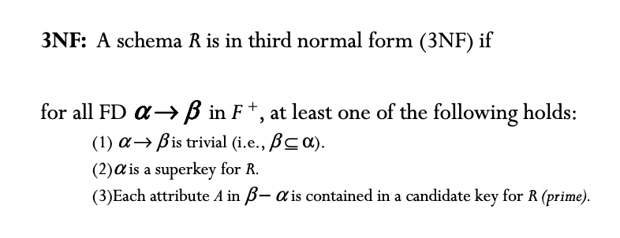
3NF decomposition

Slide 5
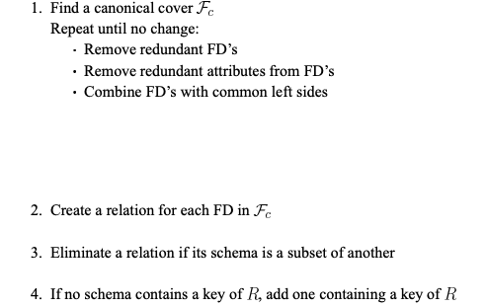
3NF Decomposition

Slide 6


Example 1
R( A, B , C, D E)
FD : A → B , B →E , C → D
CK = AC
Check whether all FD are in 3NF
A → B - No
B → E – No
C → D – No
$$α −A$$
$$β−B$$

Slide 7
Example 1 DECOMPOSITION
A → B - No
B → E – No
C → D – No
(A)+ = ABE
R1(A,B) R2(B,E) - step 2
R3( C , D) - step 2
R4 ( A ,C) - step 4
R(ABCDE)
R1( A, B) R2( B, E) R3( C, D) R4 ( A , C)

Slide 8
Example 2
AB → C
A → DE
B → F
F → GH
D → IJ
Find CK ?
AB
find FD is in 3NF
AB → C - VALID. AB is super key
A→ DE – Not Valid A is not super key
(A)+ = A D E I J
R11(A D E) R12 ( D I J )
AB → C
B → F
F → GH
R2 ( B F G H)
R21( B F) R22( F G H )
CK is not involved in any table so
R3( A B C)

Slide 9
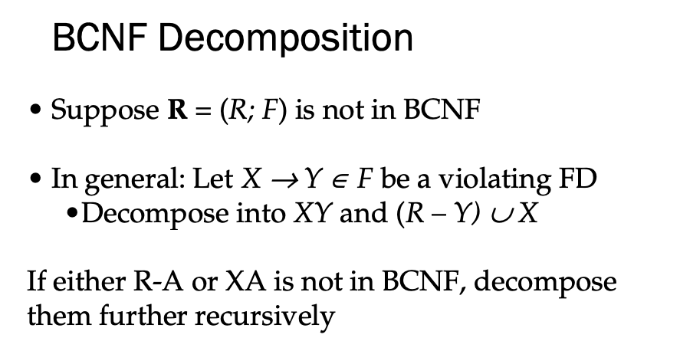

Slide 10
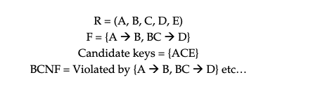
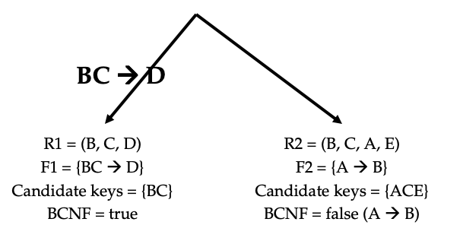
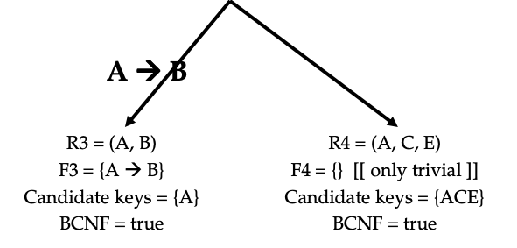
Example 1
(R-Y) U X
((A B C D E) – D ) U BC
( B C A E ) U (B C)
R2 ( B C A E)
(R-Y) U X
(( B C A E) – B ) U A
( A C E ) U (A)
R2 ( A C E )

Slide 11
R ( A B C D )
FD= { B → C , C→A , C→ D}
Ck = B
R - Y U X
(A B C D) – D U C
A B C
C→ D
Key = C
BCNF = true
R2(A BC)
Key = B
BCNF = False
R - Y U X
(A B C) – A U C
B C
C → A
Key = C
BCNF = True
R3(BC)
FD = B → C
Key = B
BCNF = True

Slide 12
THANK YOU

